Slide 1
A Deep Learning Approach for the Coconut Tree Disease Detection
Munna Biswas
ID : 221-15-5261
And
Md. Monowar Hossain
ID : 221-15-5366
Department of CSE
Daffodil International University
Mr. Abdus Sattar
Assistant Professor
Department Of CSE
Daffodil International University

Slide 2
Outline
Introduction
Problem Statement
Motivation and Objective
Related Works
Comparison Between Existing Works
Gap Analysis
Proposed Methodology
Q & A

Slide 3
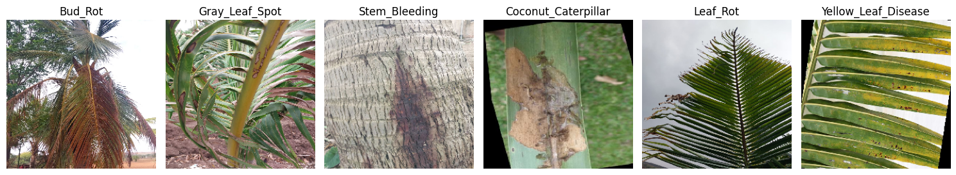
Introduction
Coconut trees are vital in tropical agriculture for food, oil, and industrial use.
Diseases such as Bud Rot, Leaf Rot, and Yellow Leaf Disease reduce yield.
Manual detection methods are error-prone and require expert knowledge.
We propose an AI-based system using CNN models for automatic disease detection using leaf images.

Slide 4
Problem Statement
Farmers lack access to efficient tools for early disease detection.
Visual symptoms vary and are often misinterpreted.
Current manual processes are slow, subjective, and require trained personnel.
Need for a scalable, accessible solution that works in real-world conditions.

Slide 5
Motivation
Coconut farming is vital in South Asia, especially Bangladesh.
Leaf & stem diseases cause major economic losses.
Manual detection is slow and often inaccurate.
AI & computer vision enable fast, real-time diagnosis.
Improves food security and boosts crop yield.

Slide 6
Objectives
The primary objectives of this study are as follows:
      To build a custom CNN model for six coconut diseases.
      To Compare Architectures for the best accuracy.
      To add XAI (Grad-CAM) for interpretability.
      To Show training curves & evaluation metrics.
      To prepare a model for future mobile/web use.

Slide 7
Related Works
Reference | Model Used | Dataset Used | Classified Findings | Findings | Limitations
[1] | YOLOv4 | Self-collected leaf disease dataset | Yellowing, Drying, Pest Infections, Flaccidity | 88% F1-Score 85% Precision | Lower accuracy, sensitive to image noise
[2] | Custom CNN | Hand-collected data | Stem Bleeding, Leaf Blight, Pest Infection | validation accuracy 96.94% | Limited dataset size, lacks variety in environmental conditions
[4] | VGG16 ResNet50 MobileNetV2 | Hand-Collected Dataset | Bud Root Dropping, Bud Rot, Gray Leaf Spot, Leaf Rot, Stem Bleeding | Accuracy 88% 94% 92% | Imbalance Dataset

Slide 8
Related Works
Reference | Model Used | Dataset Used | Classified Findings | Findings | Limitations
[12] | Inception V3 model | Public Dataset | Yellowing, Drying, Pest Infections, Flaccidity | Accurate real-time prediction | Integrating XAI improves trust but increases processing time
[25] | MobileNetV2 | Collected from multiple public datasets | Coconut Leaf Disease, Coconut Disease | accuracy 99.2% | Risk of overfitting without augmentation; needs real-world testing
[29] | VGG | Public dataset | Grape Leaves Disease, Tomato Leaves Disease | Accuracy 98.40% 95.71% | Not coconut-specific. accuracy may drop on coconut images.

Slide 9
Comparison Between Existing Works
Model | Pros | Cons
Custom CNN [2] | High accuracy (96.9%) | Limited dataset variety
VGG16, ResNet50, MobileNetV2 [4] | ResNet50 highest accuracy (94%) | Imbalanced dataset
Inception V3 + XAI [12] | Real-time & explainable | Slower with XAI
MobileNetV2 [25] | Very high accuracy (99.2%) | Risk of overfitting
VGG [29] | High accuracy on other crops | Not coconut-specific

Slide 10
Gap Analysis
Limited studies on coconut tree diseases using deep learning.
Lack of public datasets for coconut leaf images.
Most models are not optimized for field-level deployment.
Only a few studies have integrated XAI.
No current tools offering real-time prediction to farmers.

Slide 11
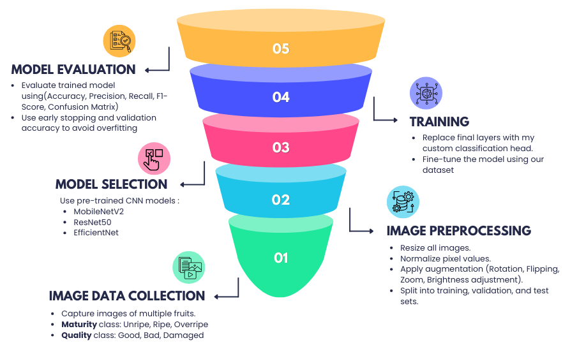
Proposed Methodology

Slide 12
THANK YOU

